Slide 1
EDI/ASCII Training
UAT Test preparation

Slide 2
Agenda
ASCII Spreadsheet Discussion
Creating test data (Important Data Points, Required fields and Information, Saving output files in the proper format)
Manipulating the files (Utilizing the ASCII guides, Understanding the breakdown of the field positions, Understanding File Structure)
Triggering Errors (Level 1 Errors, Level 2 Errors)
Understanding the Interface
Exercise Manipulating files
Questions/Concerns

Slide 3
Ascii Spreadsheet Discussion
ASCII Master_V001 vs ASCII Master_Rays Version
Excel Spreadsheet Schedule Issues document
Master_V001 – Latest with removal of BT details as requested by DMV
Master_Rays_Version – Highlighted sections where not required by VAETS etc (See Spreadsheet)

Slide 4
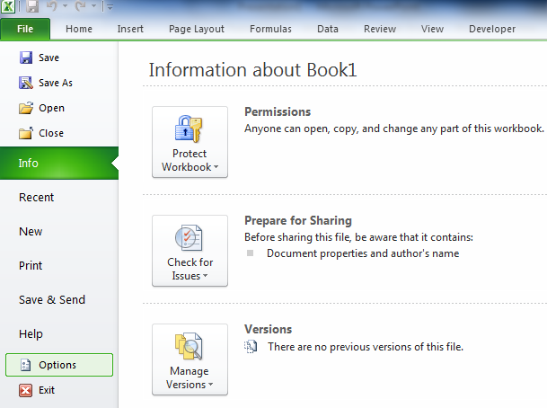
Enabling macros

Slide 5
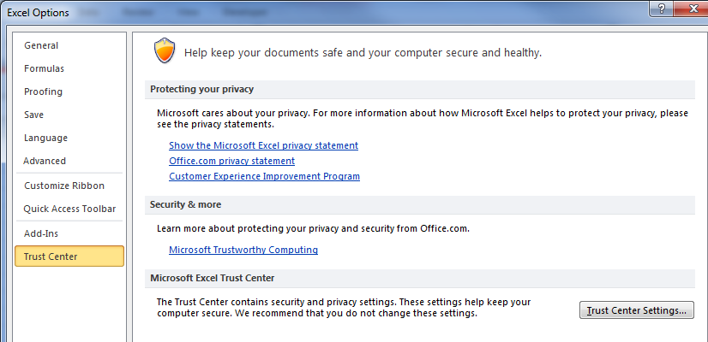
Enabling Macros
After selecting Options you will need to select Trust Center and subsequently Trust Center Settings

Slide 6
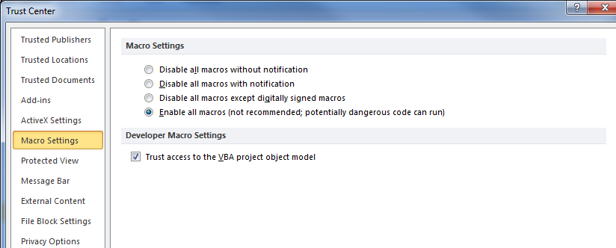
Enabling macros
Select Enable to be able to utilize the spreadsheets macros and select ok after this prompt

Slide 7
Creating test data
Test Data is in exported from the spreadsheet in a .txt however we need to also test .dat format. *Notepad is needed in order to facilitate testing
Key Data Points/Required Fields
FEIN- Must be existing in VAETS
Return Period- Must be valid return period
License number – Must exist in VAETS
TCN- Must be a valid TCN for applicable License types
When creating test accounts please keep track of your FEIN numbers as well as the license numbers that you are creating for those specific accounts as they will be necessary to submit your returns

Slide 8
Creating test data
Sample File Creation using AC on the ASCII spreadsheet
Data Entry process
Txt file creation
Converting the .txt into a .dat

Slide 9
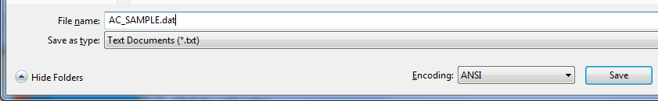
Creating test data
Converting the file into the proper format is important as the ASCII spreadsheet will generate a text file. I will show you how to convert your sample file into a .dat file.
Open the notepad file generated by the spreadsheet
Select File and the ‘Save As’
In the name field add ‘.dat’ to the end of the file name as shown below and select ‘Save’

Slide 10
Manipulating the files
Key points to file manipulation
Each license has it’s own ASCII guide for file layout
Every file has the same length (positions); 576
Removals of information must be space filled
Depending on the tax type different the same position could have two different field descriptions/values so understanding/using the guide will be helpful for testing/troubleshooting.

Slide 11
Triggering errors
EDI Level 1 Errors
Lets take a look at the ASCII File level 1 errors on page 52 of Sprint 3 Deliv.
5 errors total
Lets walk through an example of how to trigger those types of errors together.

Slide 12
Triggering errors
EDI Level 2 Errors
Lets take a look at the ASCII File level 2 errors on page 54 of Sprint 3 Deliv.
Lets walk through an example of how to trigger those types of errors together.

Slide 13
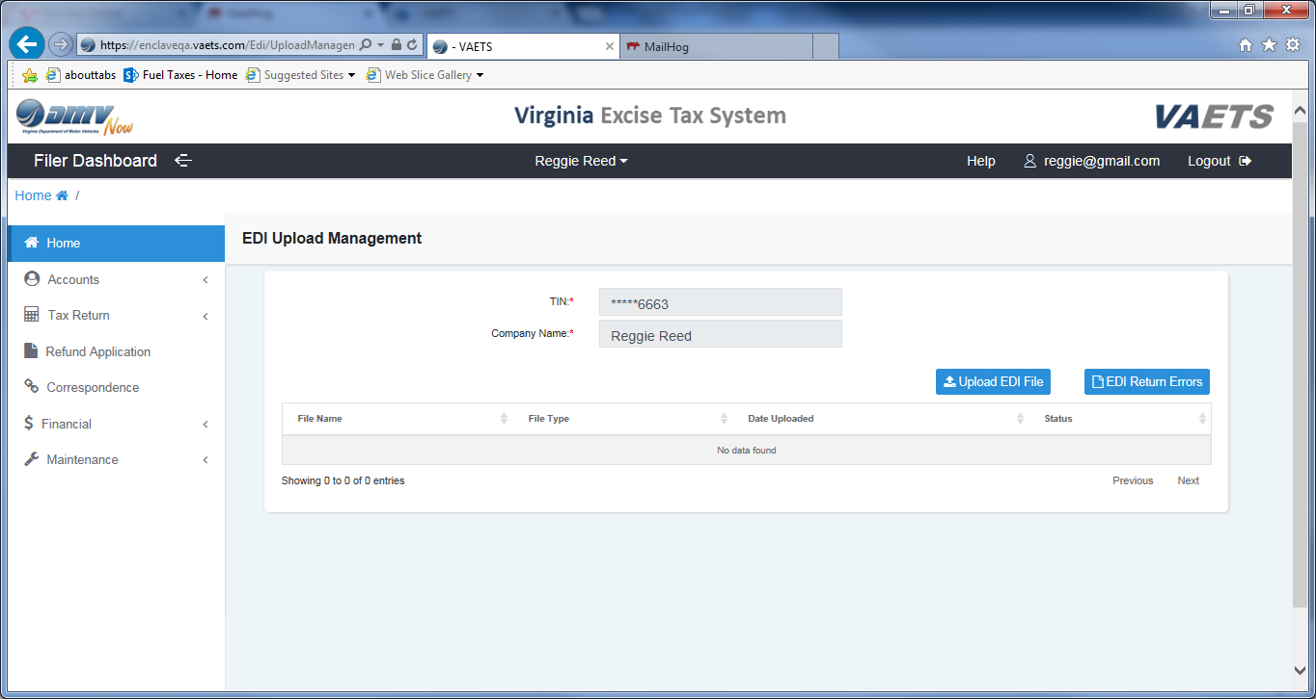
Understanding the interface

Slide 14

Understanding the interface

Slide 15
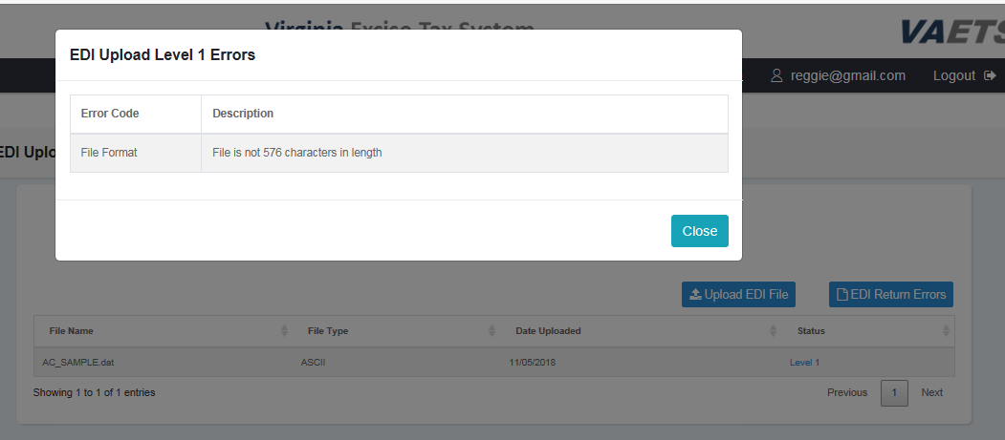
User interface samples

Slide 16
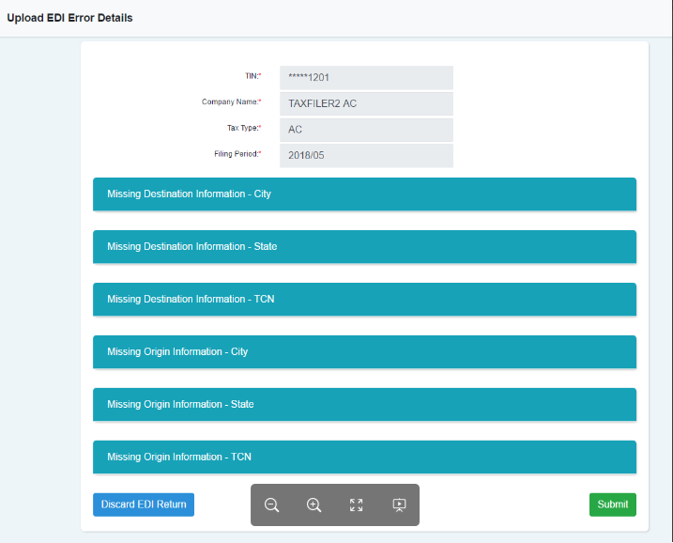
Sample level 2 display

Slide 17
exercises
Using the ASCII Master Spreadsheet complete the following tasks:
Create a sample AC file
Convert the file into a .dat file
Update the file to reflect a Level 1 Error

Slide 18
Questions/Concerns?

Slide 19
Thank you!!!!!!!!! Good Luck with testing

